Slide 1



CULTURE SPOT 3
Schools in the UK

Slide 2
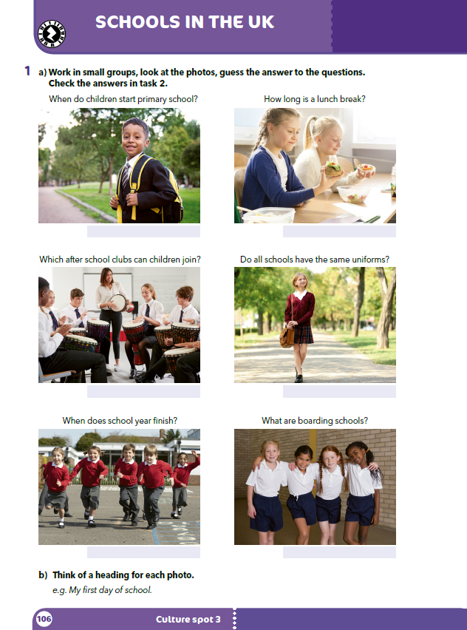
Look at the photos and describe them.
Guess the answers to the questions above the photos?

Slide 3
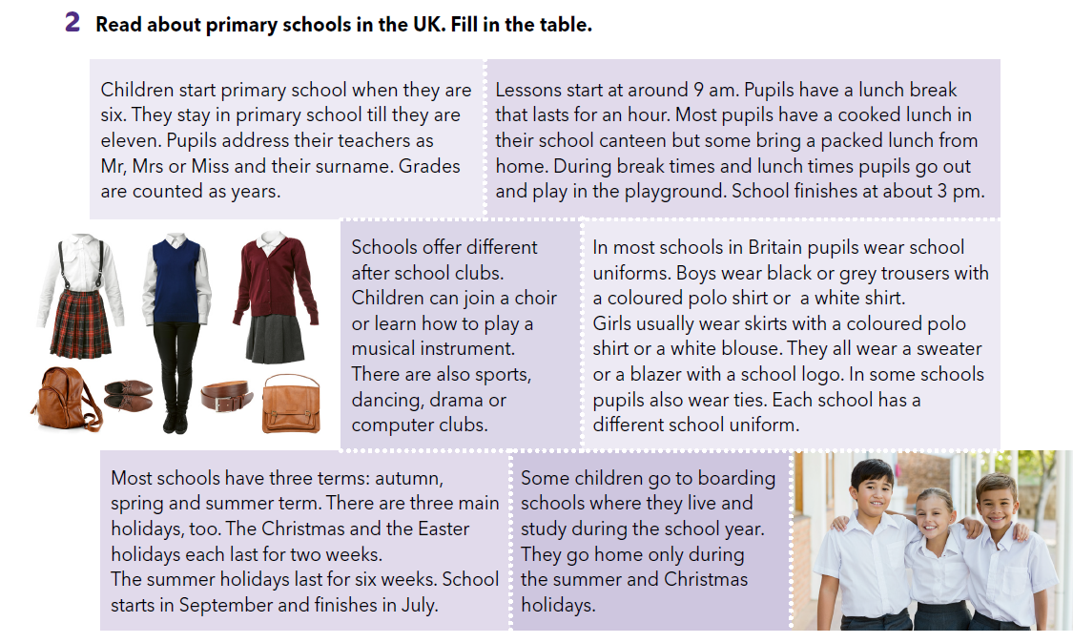
Read the text and check your answers.

Slide 4
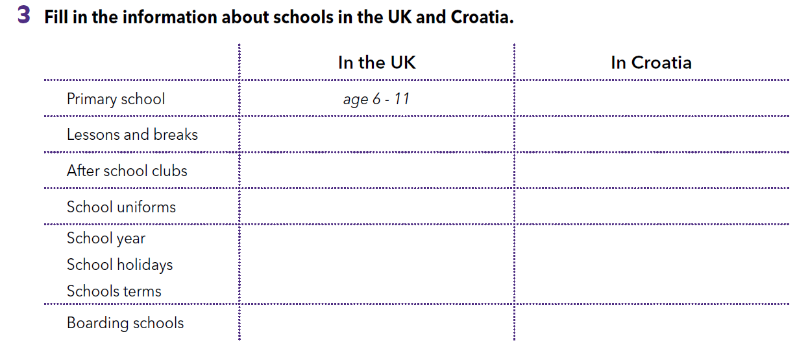
Read the text again and fill in the table.

Slide 5
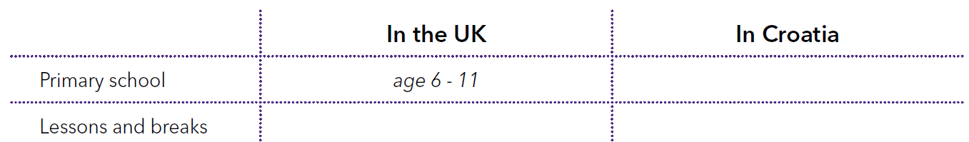
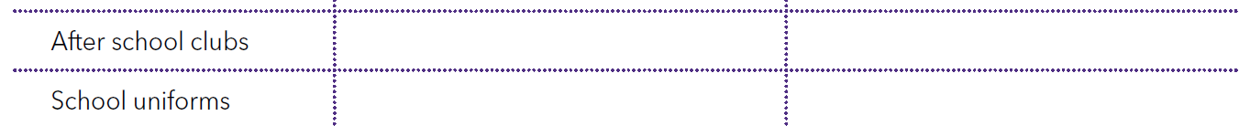
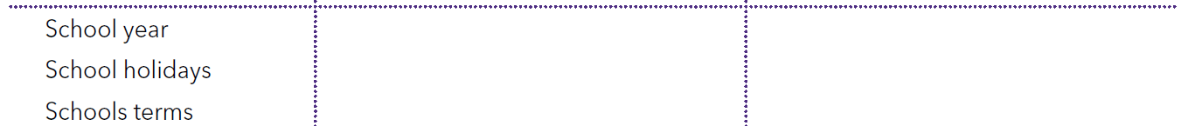
Check.
age 6/7 – 13/14
lessons start at 9; a lunch break lasts for an hour
Usually there are 2 shifts; in the morning lessons start at 8 and in the afternoon at 2; the longest break is 15 minutes long and there is a 5-minute break after every lesson.
different after school clubs
different after school clubs
pupils wear uniforms
pupils don’t wear uniforms
schools have three terms; there are three main holidays; school starts in September and finishes in July.
schools have two terms; there are three main holidays; school starts in September and finishes in June.
some children go to boarding schools
there are no boarding schools

Slide 6
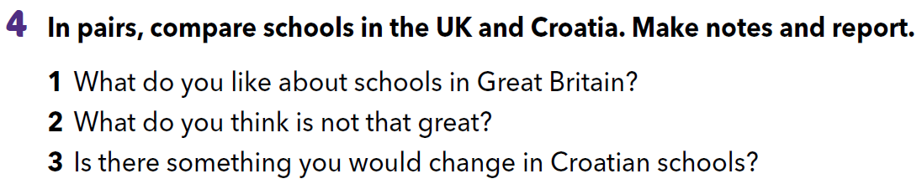

Slide 7
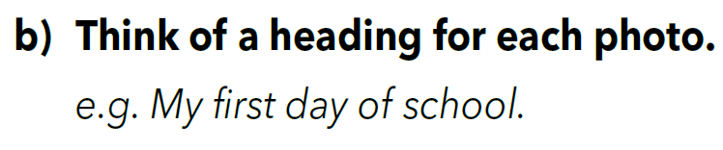

Slide 8
Check your knowlewdge.
https://wordwall.net/play/260/300/219

